Slide 1
How To Create Google Meet
Online Session

Slide 2
Open Google Mail Webpage
http://gmail.com

Slide 3
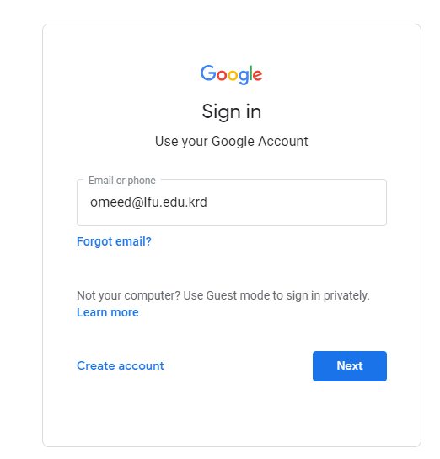

Slide 4
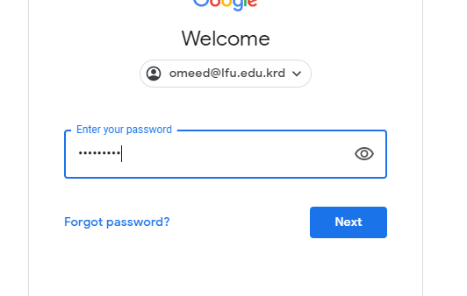

Slide 5
Opening Google Meet
To open Google Meet enter to this link
https://meet.google.com/

Slide 6
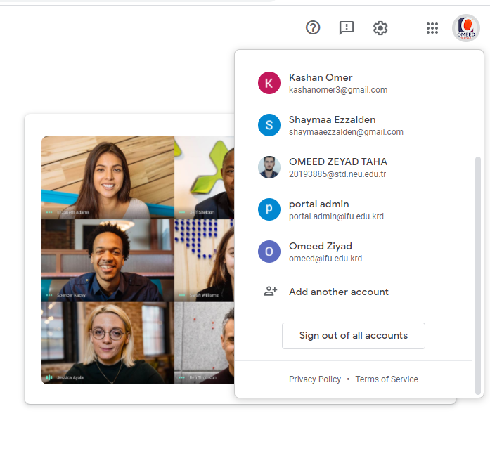
Rest assured that you are using the email of the French Lebanese University.

Slide 7
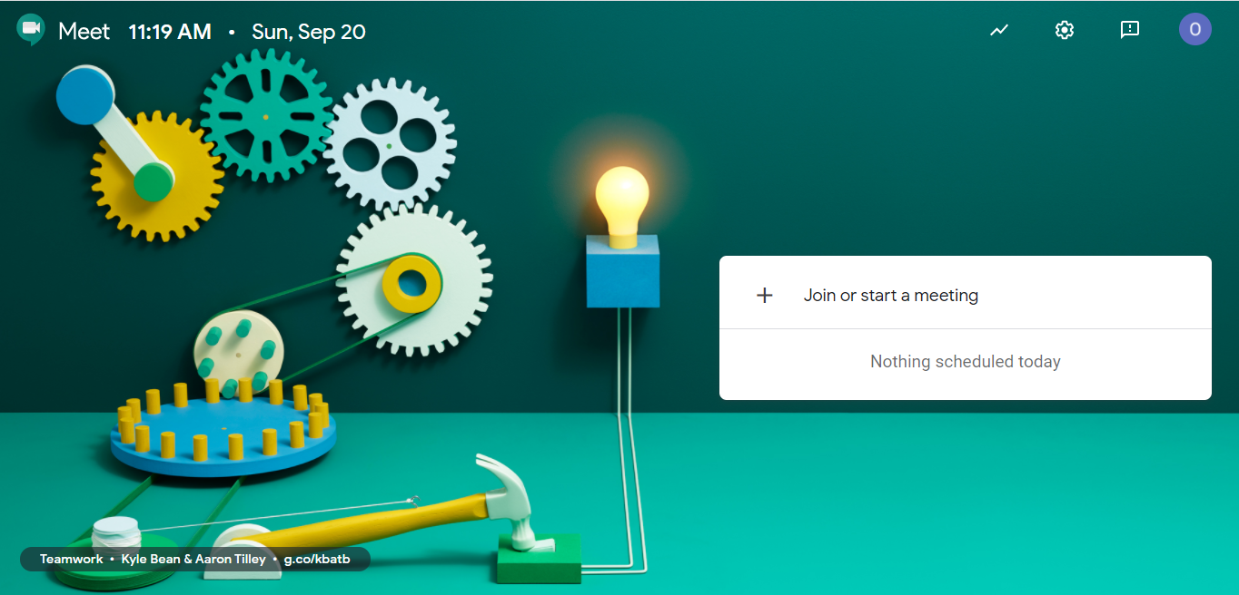
Google Meet Interface

Slide 8
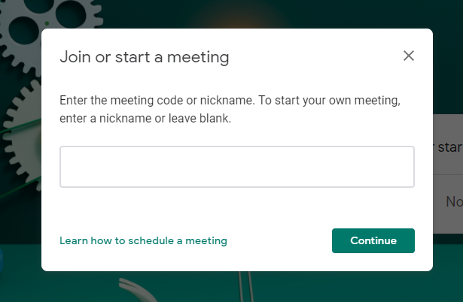
Direct Meeting Room
Leave It empty

Slide 9
Scheduled Google Meet
You Have to enter this web link
https://calendar.google.com/

