Slide 1
How faculty members setting up and taking students’ attendance
By: Zanyar Rzgar Ahmed

Slide 2
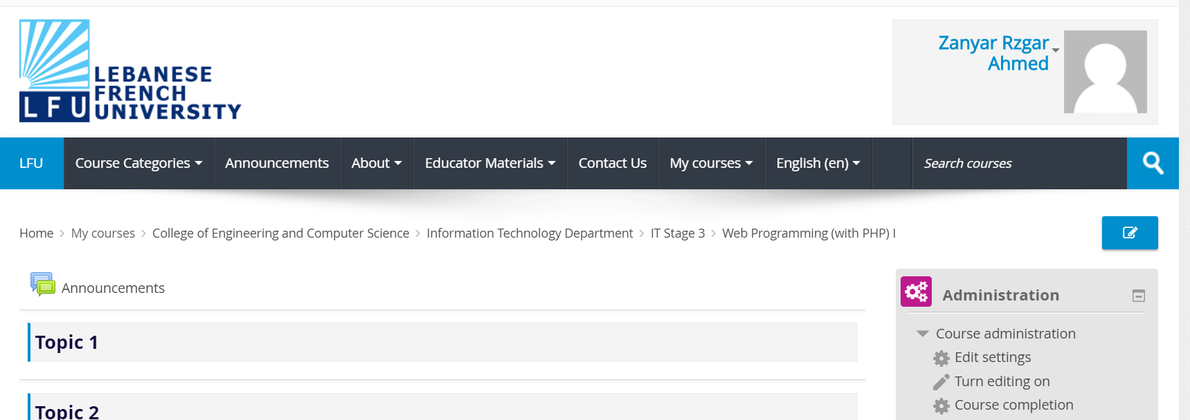
Add an Assignment Activity in Moodle
Login to your account .
Make sure your role in Moodle is switched to Teacher.
Click on Courses and Select a Course that you want add Grade.
2

Slide 3
Within the course you enrolled, click on "Turn editing on (pencil icon , top right) on the Administration panel;

Slide 4
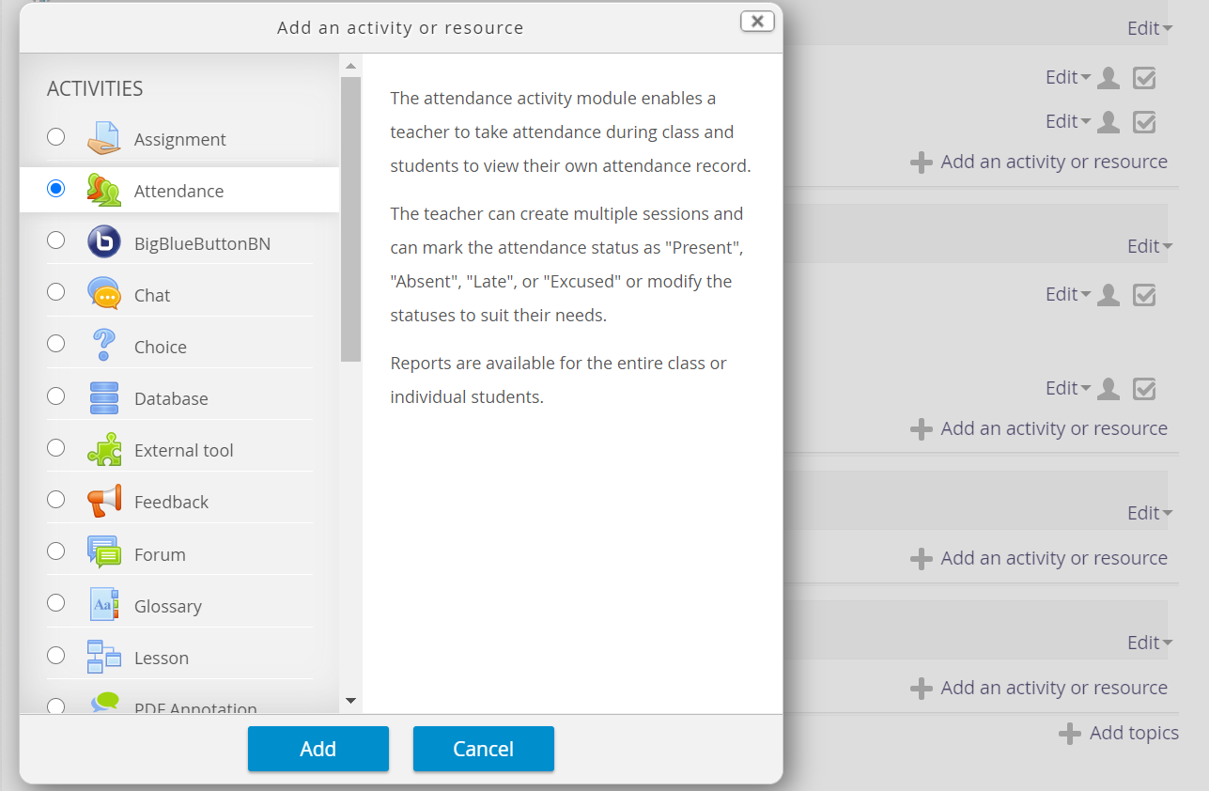
1
2
On the exact week in outline, click "Add an activity“.
select “Attendance " at the drop-down list
Click on Add button.
3

Slide 5
1
Specify the attendance options such as Name, Description , Maximum grade.
2
1

Slide 6
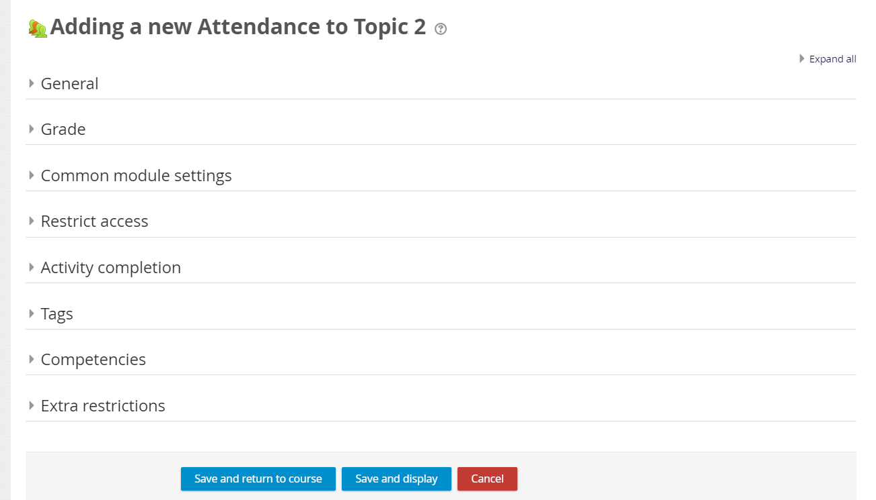
Once all settings done, click on Save and Display

Slide 7
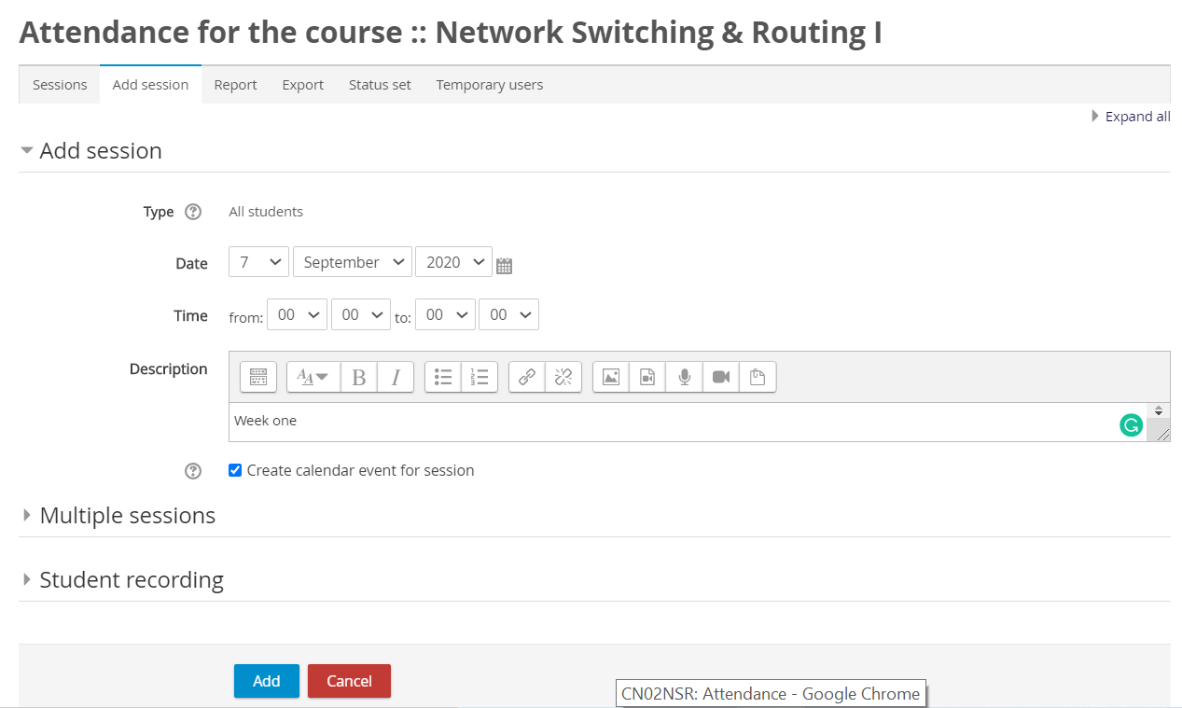
Click on Add session.
Specify the attendance options such as date, Time, Description, and Add button.

Slide 8
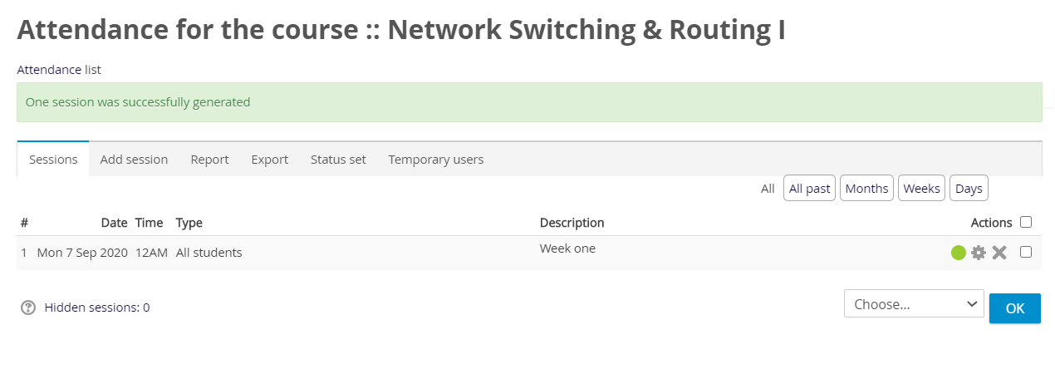
Click on Green circle “ take attendance ”.

Slide 9
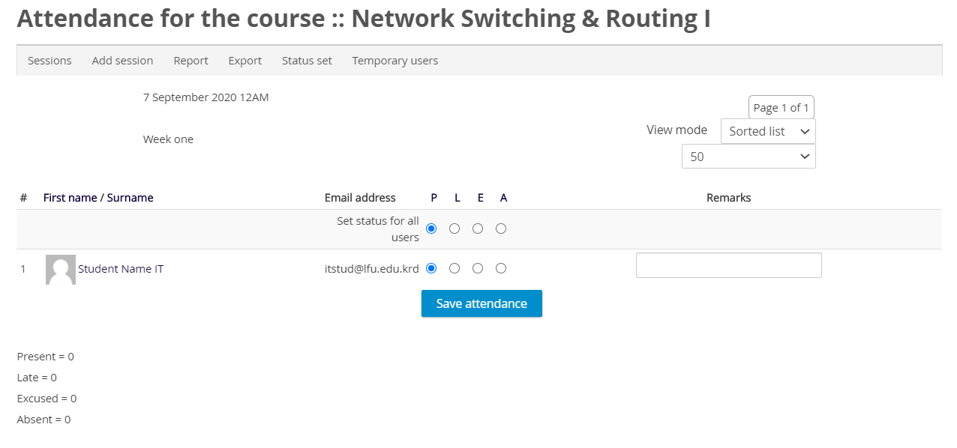
On the Attendance page, click the radio buttons to mark attendance based on the acronyms you established in the Settings tab.
By default, the status descriptions are "Present", "Absent", "Late", and "Excused".
Note: If everyone is present, click the column heading P in the Set status for all users to record the entire class as present. If most students are present, you can save time by doing this to mark everyone present, then going back to change the mark for absent students.
Once all students have been checked click on Save Attendance button.

