Slide 1
How faculty members create students’ feedback on Moodle
By
Badr Muhammed Tahir Mustafa

Slide 2
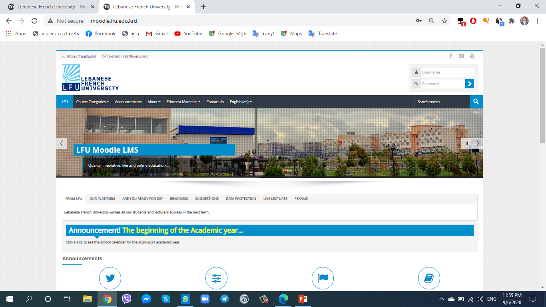
Student’s Feedback Steps
First click on LFU Moodle Link
http://moodle.lfu.edu.krd/
OR
Click on Moodle on the LFU website

Slide 3
Student’s Feedback Steps
After that enter your Username and Password.

Slide 4
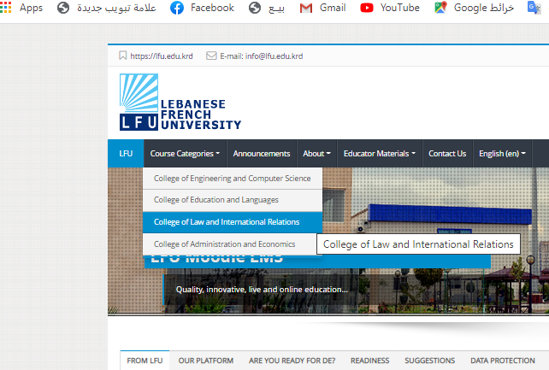
Student’s Feedback Steps
After that, this picture will appear, click on Course Categories. A list of College names will appear click on your college for example College of Law and International Relations.

Slide 5
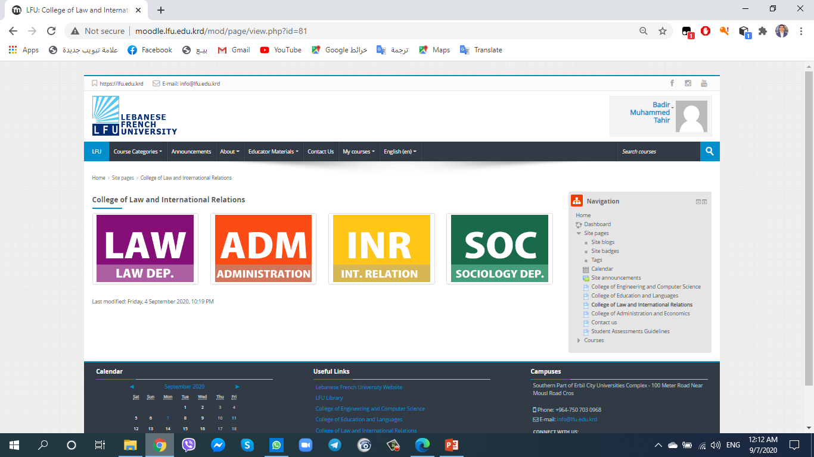
Student’s Feedback Steps
After that choose your Department for example
Law Department.

Slide 6
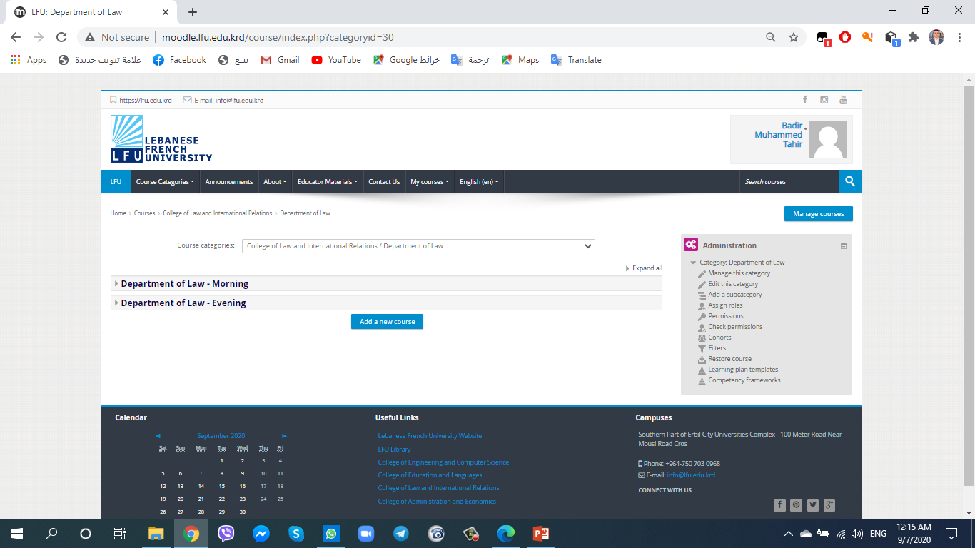
Student’s Feedback Steps
After you have chosen your Department, go to your type of study morning or evening.

Slide 7
Student’s Feedback Steps
Then choose the grade or stage that you want, for example, 1st Grade.

Slide 8
Student’s Feedback Steps
After you clicked on grade or stage that you want a list of Course Topic in this grade will appear.
Choose your course topic.

Slide 9
Student’s Feedback Steps
After you choose your main Course Topic, this wall will appear.
On the Right side of screen you have a list click on (Turn Editing On).

Slide 10
Student’s Feedback Steps
After that, on each sub-topics there is ( Add an Activity or Resource) click on it.

Slide 11
Student’s Feedback Steps
Then a list will appear, in this list choose Feedback and click on Add.

Slide 12
Student’s Feedback Steps
After that a new screen will appear, so you could fill in all information about your feedback, for example, name of your feedback a description of your feed back. At the end click on Save.

Slide 13
Thank You

